Slide 1
Notes:
Good afternoon everyone! I know it was a long day and I will do my best to manage the group fatigue. In fact, you can all stop paying attention right now. During the next 3 minutes, I will address a problem that no one ever had.
-- 15’’ --
-> 15’’ --

Slide 2
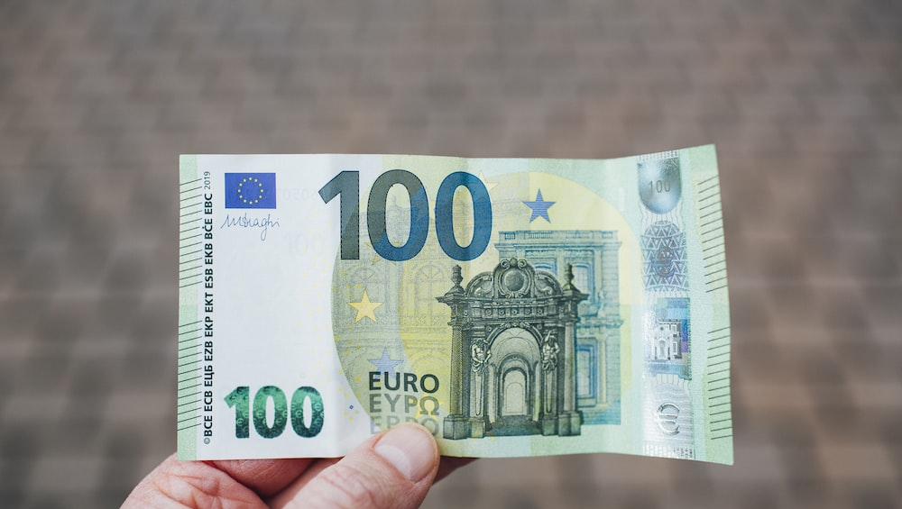
SpEnD
HOW TO SPEND
Notes:
I know it sounds like a ridiculous issue. But if you wander how to use that 100 euros to make the most good around you, it becomes very hard to know where it would be most effective!
The first question that comes to mind is why would it be MY problem?
-- 20’’ --
-> 35’’ --

Slide 3
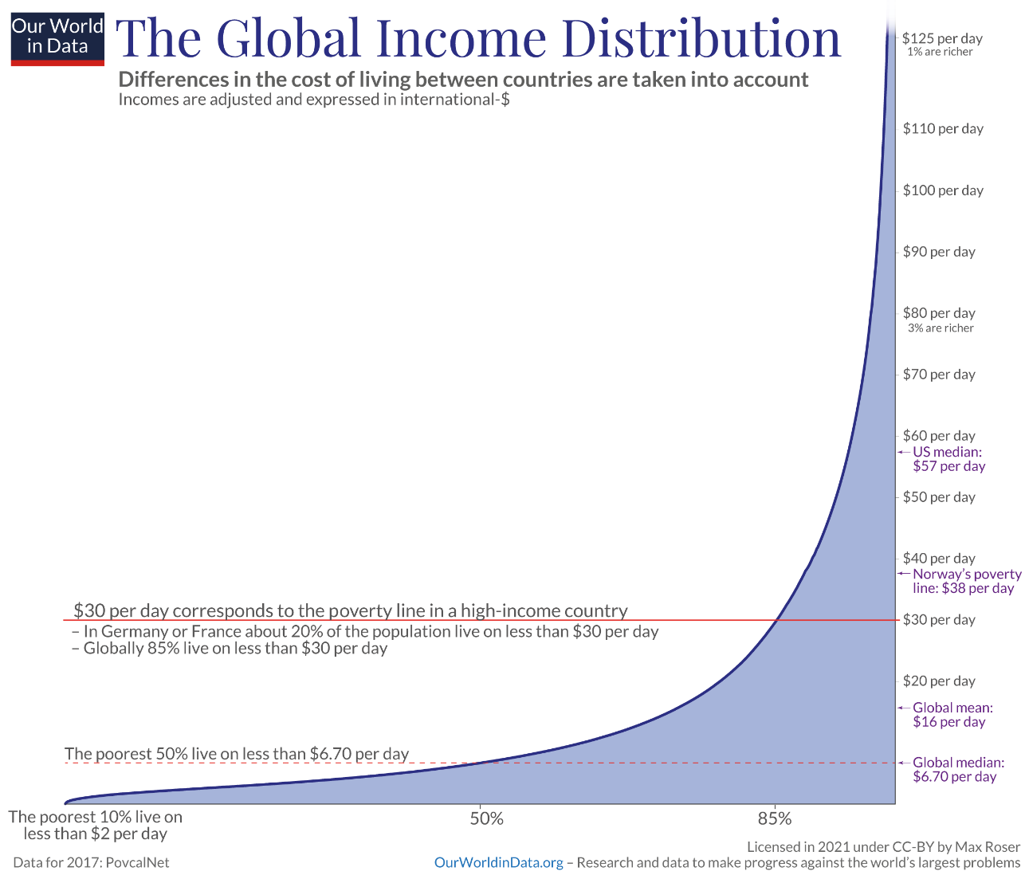


WHY IS IT MY problem?
Notes:
It rather sounds like an Elon Musk, Jeff Besos, and Bill Gates kind of problem! But if you look closely at the global income distribution, as average Vlerick students, WE belong to the richest 3 percent in the world and WE have a real chance at making a difference.
By now you might be wondering how is it a difficult problem? Can’t I just give my money wherever it feels right?
-- 30’’ --
-> 1’05’’ --

Slide 4
WHY IS IT DIFFICULT TO SOLVE?
Improving school attendance
(Numbers of years of additional schooling per $1,000)
0.2
3
7
Cash transfer to girls | Merit scholarships | Free uniforms | Deworming
Notes:
The issue is that we are terribly bad at allocating our money when it comes to charities. And that is because we have no idea what works best.
Image you have made your research and decided that making education more equal would be the best way to bring more equality in the workplace. You convinced Vlerick to donate 1000 dollars and you want to use it to improve school attendance (measured as the number of years of additional schooling).
Let everyone make a choice of what charity would be the most efficient.
Done?
-- 30’’ --
-> 1’35’’ --

Slide 5
WHY IS IT DIFFICULT TO SOLVE?
Improving school attendance
(Numbers of years of additional schooling per $1,000)
7
3
139
0.2
Cash transfer to girls | Merit scholarships | Free uniforms | Deworming
Notes:
Yeah… I would also have been fooled and picked merit scholarship. If some of you picked free uniforms, congrats.
-- 10’’ --
-> 1’45’’ --

Slide 6
WHY IS IT DIFFICULT TO SOLVE?
Improving school attendance
(Numbers of years of additional schooling per $1,000)
139
0.2
3
7
Cash transfer to girls | Merit scholarships | Free uniforms | Deworming
Notes:
However, I am quite certain that no one in this class would have thought of Deworming as a possible solution, eventhough its impact literally dwarves the impact of the other charities.
So the final question is how can we make the right choice?
-- 10’’ --
-> 1’55’’ --

Slide 7

What can solve that problem
Notes:
Well, brilliant minds have asked themselves that exact same question and wrote papers about it.
-- 5’’ --
-> 2’00’’ --

Slide 8
What can solve that problem
Notes:
MANY papers…
-- 5’’ --
-> 2’05’’ --

Slide 9
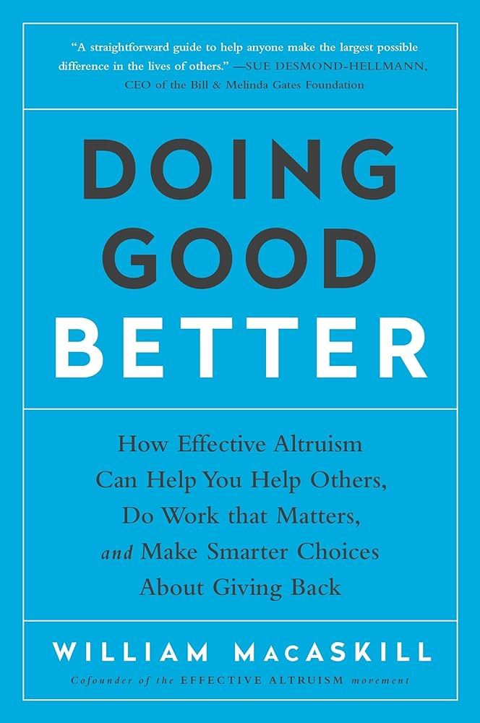
What can solve that problem
A straightforward guide to help anyone make the largest possible difference in the lives of others. - CEO of the Bill & Melinda Gates Foundation
For less than 10€:
How many people benefit and by how much?
Is this the most effective thing you can do?
Is this a neglected area?
What would have happened otherwise?
What are the chances of success, and how good would success be?
Notes:
Luckily, Doing Good Better by William MackAskill exists.
For less than 10€, you will have access to a brilliant, yet very understandable summary of the research on the topic.
MacAskill’s book will teach you how to donate wisely by considering the following questions.
-- 25’’ --
-> 2’30’’ --

Slide 10
What can solve that problem
« A straightforward guide to help anyone make the largest possible difference in the lives of others. Framed around a series of insightful questions backed by thorough analyses, Doing Good Better reads like a mash-up of introductory economics and MacAskill’s own philosophy about how to make the world a better place.» - Sue Desmond-Hellman CEO of the Bill & Melinda Gates Foundation
For less than 10€:
How many people benefit and by how much?
Is this the most effective thing you can do?
Is this a neglected area?
What would have happened otherwise?
What are the chances of success, and how good would success be?
Notes:
If I failed to convince you to buy that book, maybe Sue Desmond-Hellman will succeed.
-- 10’’ --
-> 2’40’’ --

Slide 11
How can consumers make the most difference?
Which careers make the most difference?
Which causes are most important?
Notes:
To conclude, let’s circle back to our big problem. Spending a 100 euros still doesn’t sound like a problem to you?
Then, Doing good better can help you with the following questions
-- 15’’ --
-> 2’55’’ --

Slide 12
How can consumers make the most difference?
Which careers make the most difference?
Which causes are most important?
Notes:
How can consumers make the most difference?
-- 5’’ --
-> 3’00’’ --

Slide 13
How can consumers make the most difference?
Which careers make the most difference?
Which causes are most important?
Notes:
Which careers make the most difference?
-- 5’’ --
-> 3’05’’ --

Slide 14
How can consumers make the most difference?
Which careers make the most difference?
Which causes are most important?
Notes:
Which causes are most important?
-- 5’’ --
-> 3’10’’ --

Slide 15
One more thing
Notes:
-- 10’’ --
-> 3’20’’ --

Slide 16
All of the author's profits will be donated to some of the world's most effective charities
Notes:
-- 10’’ --
-> 3’30’’ --

